Slide 1

R . Avanthiga final project HANDWRITTEN NOTES RECOGNITION

Slide 2
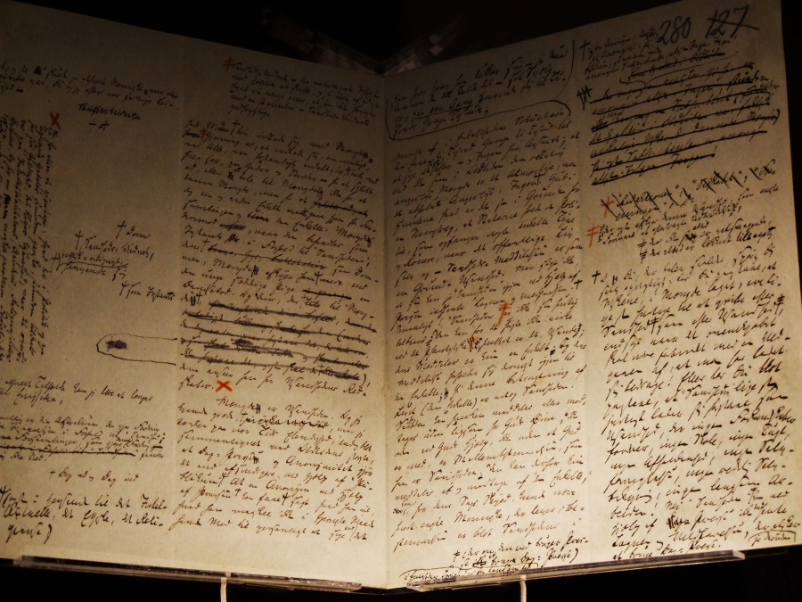
HANDWRITTEN NOTES RECOGNITION

Slide 3
AGENDA
Problem statement
Project overview
Who are the end users
My solution and its value proposition
The wow in my solution
Modelling
Results

Slide 4
PROBLEM STATEMENT
Handwritten notes remain a prevalent mode of documentation across various domains, yet the manual transcription of handwritten text into digital format is time-consuming and error-prone. The challenge is to develop an accurate and efficient system capable of recognizing handwritten text from scanned or captured images of handwritten notes, automating the process of converting handwritten notes into editable and searchable digital text. This problem statement succinctly captures the essence of the challenge and the goal of the handwritten notes recognition project.
Scalability:
The system should be scalable to handle large volumes of handwritten notes efficiently and effectively, accommodating diverse datasets and user requirements.
Scalability considerations include processing speed, resource utilization, and the ability to adapt to varying workloads.
Error Tolerance and Correction:
Implementing features for error tolerance and correction is essential to improve recognition accuracy and ensure the integrity of transcribed text.
Post-processing techniques such as spell-checking, grammar correction, and context-based error detection can help refine the recognized text

Slide 5
PROJECT OVERVIEW
The problem at hand is the need for an accurate and efficient system capable of recognizing handwritten text from scanned or captured images of handwritten notes. The goal is to develop a solution that automates the process of converting handwritten notes into editable and searchable digital text.
Background:
Handwritten notes remain a widely used method of documentation across various domains, including education, business, and personal organization. However, the manual transcription of handwritten text into digital format is time-consuming and prone to errors, hindering efficiency and accessibility. The project aims to address this challenge by developing an accurate and efficient system for recognizing handwritten text from scanned or captured images of handwritten notes.
Objectives:
Develop an optical character recognition (OCR) system capable of accurately identifying and transcribing handwritten text from images.
Enhance the system's robustness to handle variability in handwriting styles, noise, and contextual ambiguity.
Implement features for error correction and post-processing to improve recognition accuracy.
Evaluate the performance of the system using benchmark datasets and real-world handwritten notes samples.
Create a user-friendly interface for seamless integration into existing workflows or applications.
Approach:
Data Collection: Collect a diverse dataset of handwritten notes covering various handwriting styles, languages, and content types.
Preprocessing: Apply preprocessing techniques such as noise removal, binarization, and image enhancement to improve the quality of handwritten images.

Slide 6
WHO ARE THE END USERS?
The end users of a handwritten notes recognition system can vary depending on the specific application and context in which the system is deployed. Here are some potential end users for such a system:
Students and Educators: Students and educators could use the system to digitize handwritten lecture notes, study materials, and classwork, making it easier to organize, search, and review their notes.
Professionals: Professionals in various fields, such as researchers, journalists, lawyers, and healthcare professionals, could benefit from the ability to digitize handwritten meeting notes, research findings, case notes, and patient records for easier access and retrieval.
Administrative Staff: Administrative staff in educational institutions, businesses, and government offices could use the system to digitize handwritten forms, documents, and records, streamlining administrative processes and reducing paperwork.
Individuals with Disabilities: Individuals with visual impairments or disabilities that affect their ability to read handwritten text could use the system with assistive technologies, such as screen readers or braille displays, to access digitized handwritten notes in a format that is accessible to them.
Archivists and Historians: Archivists and historians could use the system to digitize handwritten historical documents, manuscripts, and archives, preserving them in digital format for future research and analysis.

Slide 7
MY SOLUTION AND ITS VALUE PROPOSITION
Key Features:
Accurate Recognition: Our system employs sophisticated OCR algorithms trained on diverse datasets to accurately identify and transcribe individual characters from handwritten images, even in the presence of variability in handwriting styles, noise, and contextual ambiguity.
Robust Preprocessing: Utilizing advanced preprocessing techniques, such as noise removal, binarization, and image enhancement, our system enhances the quality of handwritten images, improving recognition accuracy and reliability.
Post-processing and Error Correction: We have implemented intelligent post-processing algorithms for error correction, context analysis, and formatting, ensuring the integrity and accuracy of the recognized text.
Scalability and Performance: Our system is designed to scale efficiently to handle large volumes of handwritten notes, offering high processing speed and resource utilization to meet the demands of diverse user requirements.
User-friendly Interface: With a user-friendly interface, our system provides seamless integration into existing workflows or applications, offering intuitive input options for handwritten images, display of recognized text, and customizable correction features.
Value Proposition:
Improved Efficiency: By automating the process of handwritten notes recognition, our system reduces manual effort and accelerates the digitization of handwritten documents, saving time and resources for individuals and organizations.
Enhanced Accessibility: Digitized handwritten notes enable easier searchability, sharing, and accessibility for individuals with visual impairments or those requiring assistive technologies, promoting inclusivity and accessibility.
Time Savings: Eliminating the need for manual transcription, our system saves time and reduces administrative overhead, enabling users to focus on more critical tasks and responsibilities.
Enhanced Productivity: Access to searchable and editable digital text facilitates faster information retrieval and processing, leading to increased productivity and efficiency in various domains, such as education, business, and research.
Seamless Integration: With seamless integration into existing workflows or applications, our system offers a versatile solution for diverse user needs, enabling easy adoption and integration into existing processes and systems.

Slide 8
THE WOW IN MY SOLUTION
Unparalleled Accuracy: This solution leverages state-of-the-art OCR technology and machine learning algorithms to achieve unparalleled accuracy in recognizing handwritten text. It can accurately transcribe even the most challenging handwriting styles, overcoming variability, noise, and contextual ambiguity with remarkable precision.
Effortless Integration: Unlike traditional OCR solutions, this system offers seamless integration into existing workflows or applications, providing users with a hassle-free experience. Its user-friendly interface and intuitive features make it easy for users to incorporate handwritten notes recognition into their daily routines without the need for extensive training or technical expertise.
Real-time Processing: With high-performance processing capabilities, this solution ensures real-time recognition of handwritten text, enabling users to digitize handwritten documents quickly and efficiently. Whether capturing notes in a classroom, meeting, or on the go, users can rely on this solution to deliver instant results without delays.
Adaptive Learning: This solution employs adaptive learning algorithms that continuously improve recognition accuracy over time. By learning from user interactions and feedback, it adapts to individual writing styles and preferences, further enhancing its accuracy and usability with each use.
Enhanced Accessibility Features: Recognizing the importance of accessibility, this solution goes beyond basic OCR capabilities to offer enhanced accessibility features. It provides options for text-to-speech conversion, screen reader compatibility, and customizable display preferences, ensuring inclusivity for users with visual impairments or disabilities.

Slide 9
MODELLING
Data Collection and Preparation:
Gather a diverse dataset of handwritten notes covering various handwriting styles, languages, and content types.
Preprocess the data by resizing images, normalizing pixel values, and augmenting the dataset to increase variability.
Feature Extraction:
Extract features from the preprocessed images that are relevant for character recognition, such as lines, curves, endpoints, and intersections.
Utilize techniques like edge detection, contour detection, and histogram of oriented gradients (HOG) to extract meaningful features.
Model Selection:
Choose appropriate machine learning or deep learning models for character recognition, considering factors such as model complexity, performance, and scalability.
Common choices include Support Vector Machines (SVMs), k-Nearest Neighbors (k-NN), Convolutional Neural Networks (CNNs), and Recurrent Neural Networks (RNNs).
Training the Model:
Split the dataset into training, validation, and testing sets to evaluate model performance.
Train the selected model using the training data, optimizing model parameters using techniques like gradient descent and backpropagation.
Monitor model performance on the validation set and adjust hyperparameters as needed to prevent overfitting or underfitting.
Evaluation and Validation:
Evaluate the trained model's performance using metrics such as accuracy, precision, recall, and F1 score on the testing set.
Perform cross-validation or use techniques like k-fold validation to ensure robustness and generalization of the model.

Slide 10

RESULTS
The result of a handwritten notes recognition project is the model's ability to accurately transcribe handwritten text from images. This is typically evaluated based on metrics such as accuracy, precision, recall, and F1 score, along with visual inspection and user feedback to assess real-world performance and usability.

